Slide 1
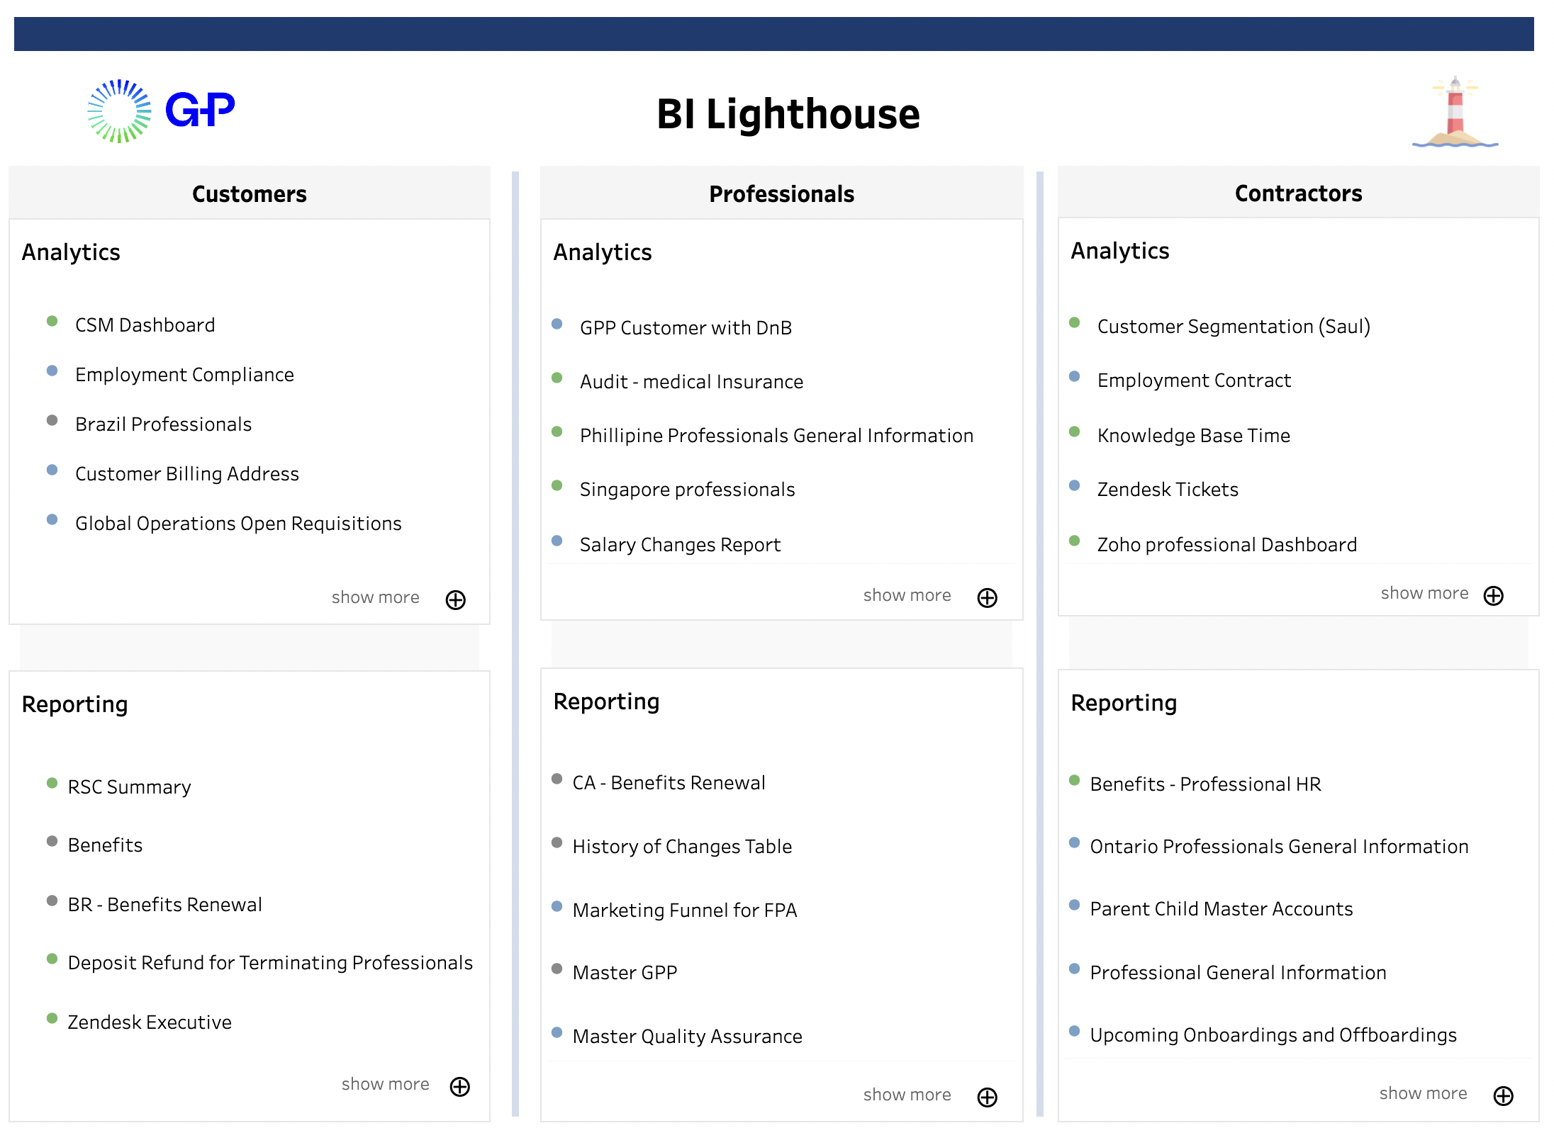
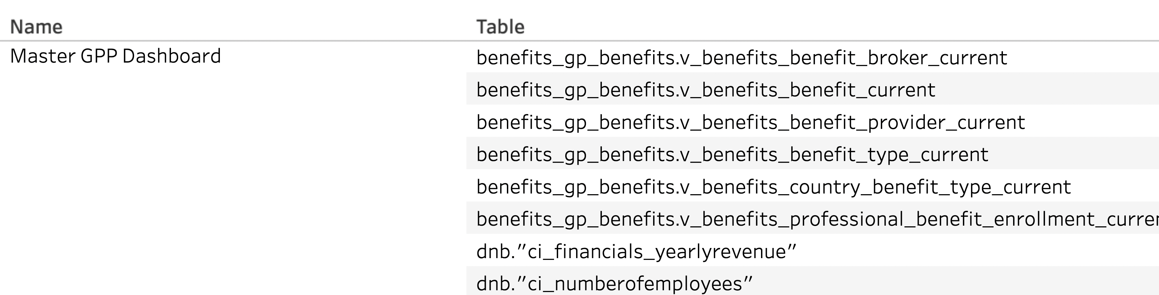
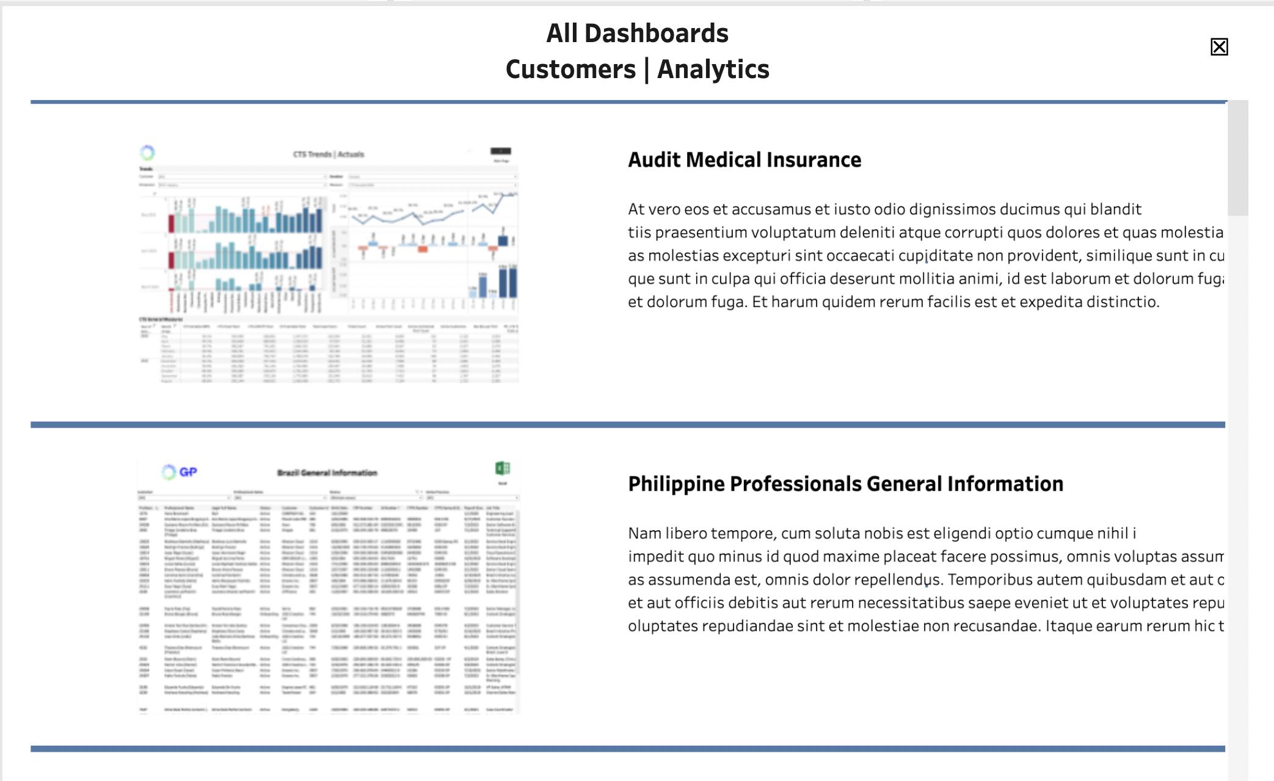
Tableau Metadata API Use Cases
BI Lighthouse Project (Landing Page)
Workbook Data Sources

Slide 2
Tableau Metadata API Use Cases
BI Lighthouse Project (Landing Page)
Workbook Data Sources
Workbook
Name
View Count
Workbook
Name
Tables used in connections &
custom queries
Description
Owner
Parent Folder
Thumbnail

Slide 3
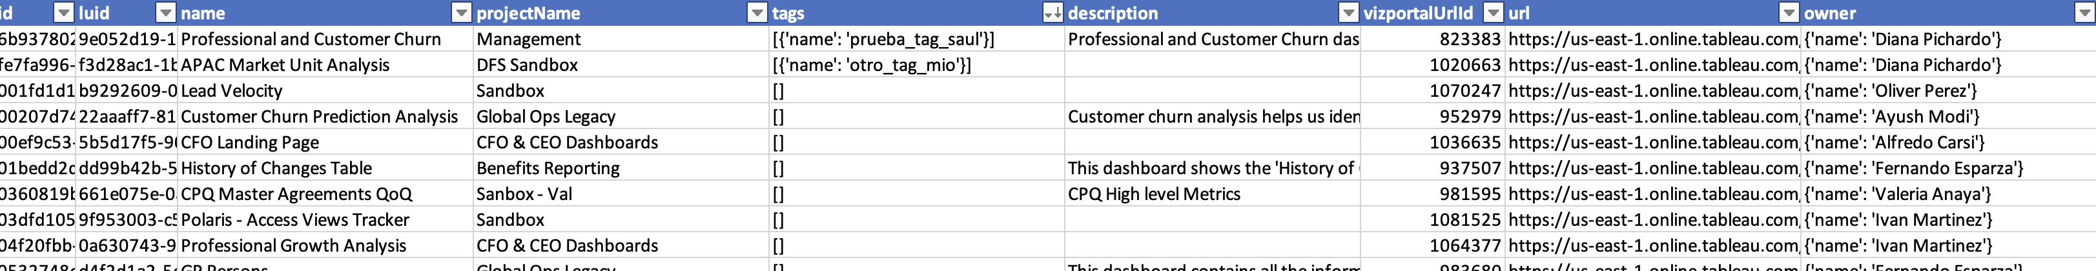
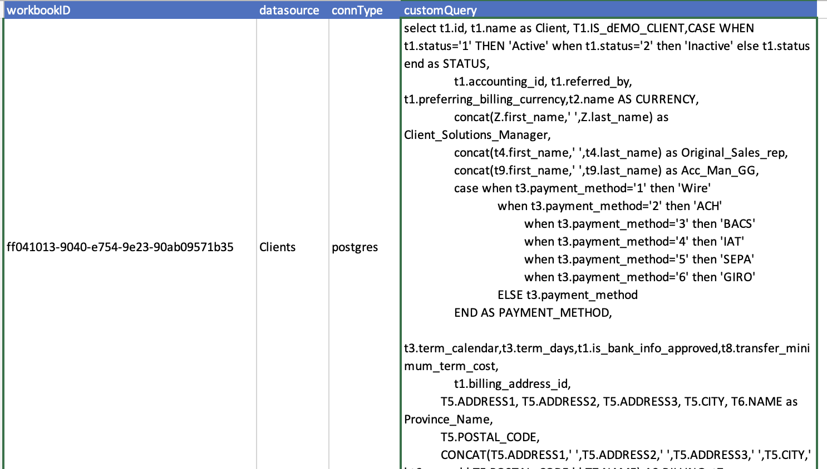
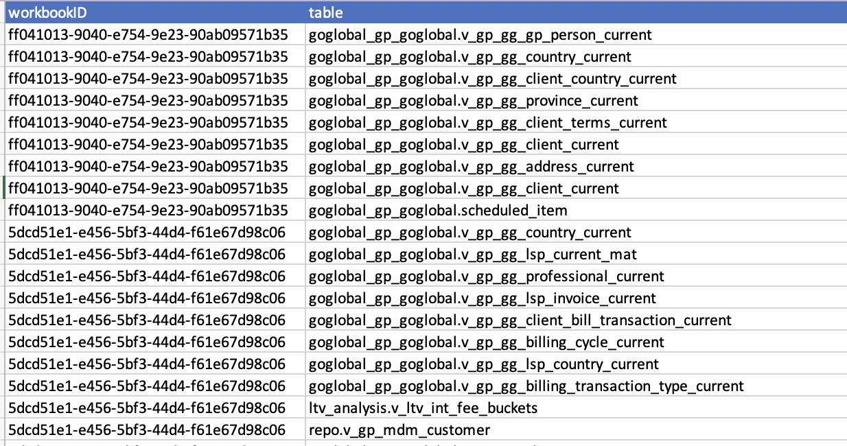
Data Structures Motivation
3 tables hold all the info needed to feed these use cases. They’re created in order, one after another.
WORKBOOK GENERAL DATA
CUSTOM QUERIES
3. TABLES FROM CUSTOM QUERIES

Slide 4
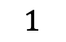


Data Structures Motivation
3 tables hold all the info needed to feed these use cases. They’re created in order, one after another.
$$∞$$
$$1$$
$$∞$$
$$∞$$

Slide 5
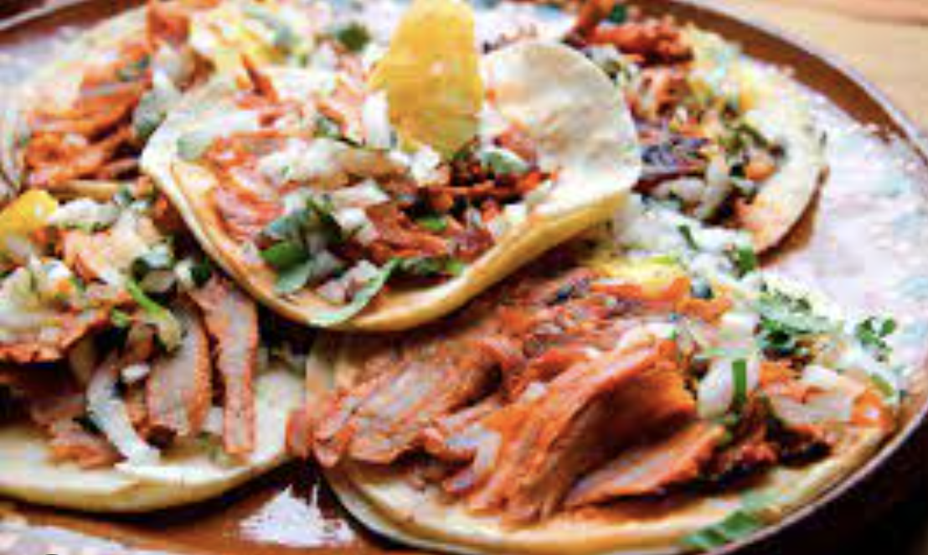

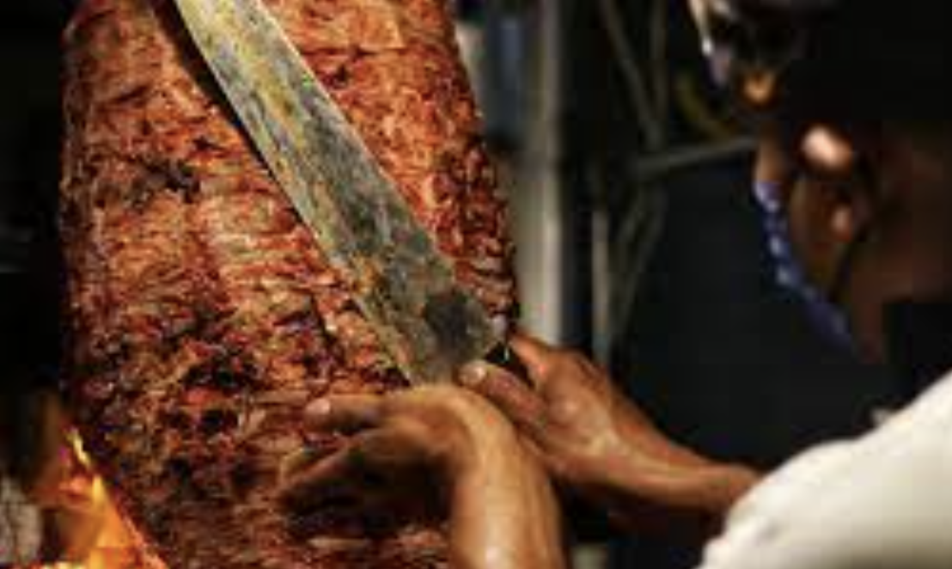
STEP 1: How is data being fetch & What is GraphQL?
Kitchen
Order
10 tacos
1 coke
Waiter reads and sends order

Slide 6


STEP 1: How is data being fetch & What is GraphQL?
Kitchen
Order
10 tacos
1 coke
Waiter reads and sends order
query EmbeddedDS{
workbooks
{
id
luid
name
projectName
tags{name}
description
vizportalUrlId
}
}
Tableau Servers
workbook
data
Python reads & sends GraphQL

Slide 7
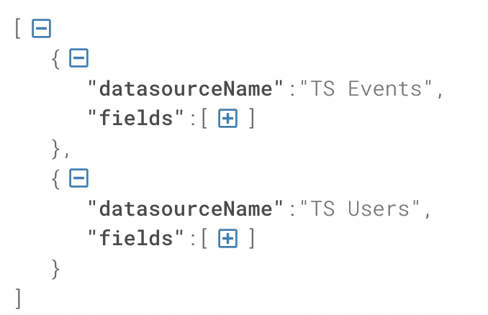
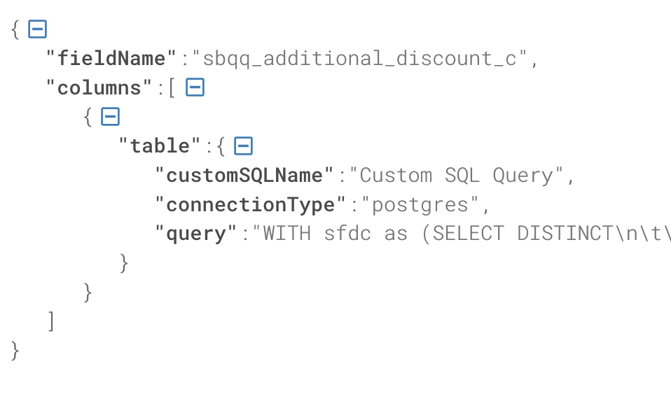
STEP 2: Custom Query Data Extraction
custom_query.graphql
Instructions needed to get the custom queries for some workbook represented by their ${id}
Id: 66953299-89d2-1ff7-c03f-12c36b761f9f
query EmbeddedDS{
workbooks
(filter: {id:"${id}"})
{
id
embeddedDS: embeddedDatasources{
datasourceName: name
fields {
fieldName: name
...on ColumnField{
columns{
table{
...on CustomSQLTable{
customSQLName: name
connectionType
query
}
}
}
}
}
}
}
}
=

Slide 8

STEP 2: Custom Query Data Extraction
custom_query.graphql
Instructions needed to get the custom queries for some workbook represented by their ${id}
-In human:
for each workbook_id
for each datasource
for each field
GET_ME_THE_CUSTOM_QUERY()
-Problem: Data comes back nested
How can we achieve this? (unnesting the data)
query EmbeddedDS{
workbooks
(filter: {id:"${id}"})
{
id
embeddedDS: embeddedDatasources{
datasourceName: name
fields {
fieldName: name
...on ColumnField{
columns{
table{
...on CustomSQLTable{
customSQLName: name
connectionType
query
}
}
}
}
}
}
}
}
=
nested_list = [ [1,2,3], [4,5,6] ]
plain_list = [element for list in nested_list for element in list]
>>> [1, 2, 3, 4, 5, 6]

Slide 9
STEP 3: Table Extraction Algorithm
select DISTINCT
cpa.ID,
cpa.user_id,
regexp_split_to_table(cpa.roles, ',') AS rol,
cpa.MODIFIED_BY,
CASE
WHEN cp.USER_ID IS NULL THEN concat(gpp.first_name,' ',gpp.last_name)
ELSE concat(cp.first_name,' ',cp.last_name)
END AS Modified,
CASE
WHEN cp.USER_ID IS NULL and gpp.user_id is not null THEN 'GP Person'
WHEN gpp.USER_ID IS NULL and cp.user_id is not null THEN 'Client Person'
WHEN gpp.USER_ID IS not NULL and cp.user_id is not null THEN 'Both'
ELSE 'None'
END AS Modified_person,
CASE WHEN cp.USER_ID IS NULL and gpp.user_id is not null THEN gpp.is_enabled
WHEN gpp.USER_ID IS NULL and cp.user_id is not null THEN cp.is_enabled
WHEN gpp.USER_ID IS not NULL and cp.user_id is not null THEN gpp.is_enabled
END AS Modifier_is_enabled,
cpa.DATE_MODIFIED,
row_number()over (partition by cpa.id,regexp_split_to_table(cpa.roles, ',') order by cpa.date_modified) as Row
from goglobal_gp_goglobal.client_person_aud cpa
left join (
select * from goglobal_gp_goglobal.V_GP_GG_client_person_CURRENT
) cp on cpa.modified_by=cp.user_id
left join goglobal_gp_goglobal.V_GP_GG_gp_person_CURRENT gpp on cpa.modified_by=gpp.user_id

Slide 10
STEP 3: Table Extraction Algorithm
select distinct
cpa.id,
cpa.user_id,
regexp_split_to_table(cpa.roles, ',') as rol,
cpa.modified_by,
case
when cp.user_id is null then concat(gpp.first_name,' ',gpp.last_name)
else concat(cp.first_name,' ',cp.last_name)
end as modified,
case
when cp.user_id is null and gpp.user_id is not null then 'gp person'
when gpp.user_id is null and cp.user_id is not null then 'client person'
when gpp.user_id is not null and cp.user_id is not null then 'both'
else 'none'
end as modified_person,
case when cp.user_id is null and gpp.user_id is not null then gpp.is_enabled
when gpp.user_id is null and cp.user_id is not null then cp.is_enabled
when gpp.user_id is not null and cp.user_id is not null then gpp.is_enabled
end as modifier_is_enabled,
cpa.date_modified,
row_number()over (partition by cpa.id,regexp_split_to_table(cpa.roles, ',') order by cpa.date_modified) as row
from goglobal_gp_goglobal.client_person_aud cpa
left join (
select * from goglobal_gp_goglobal.v_gp_gg_client_person_current
) cp on cpa.modified_by=cp.user_id
left join goglobal_gp_goglobal.v_gp_gg_gp_person_current gpp on cpa.modified_by=gpp.user_id
def _get_customquery_tables(q):
q = q.lower().replace('\n',' ')

Slide 11
STEP 3: Table Extraction Algorithm
select distinct
cpa.id,
cpa.user_id,
regexp_split_to_table(cpa.roles, ',') as rol,
cpa.modified_by,
case
when cp.user_id is null then concat(gpp.first_name,' ',gpp.last_name)
else concat(cp.first_name,' ',cp.last_name)
end as modified,
case
when cp.user_id is null and gpp.user_id is not null then 'gp person'
when gpp.user_id is null and cp.user_id is not null then 'client person'
when gpp.user_id is not null and cp.user_id is not null then 'both'
else 'none'
end as modified_person,
case when cp.user_id is null and gpp.user_id is not null then gpp.is_enabled
when gpp.user_id is null and cp.user_id is not null then cp.is_enabled
when gpp.user_id is not null and cp.user_id is not null then gpp.is_enabled
end as modifier_is_enabled,
cpa.date_modified,
row_number()over (partition by cpa.id,regexp_split_to_table(cpa.roles, ',') order by cpa.date_modified) as row
from goglobal_gp_goglobal.client_person_aud cpa
left join (
select * from goglobal_gp_goglobal.v_gp_gg_client_person_current
) cp on cpa.modified_by=cp.user_id
left join goglobal_gp_goglobal.v_gp_gg_gp_person_current gpp on cpa.modified_by=gpp.user_id
def _get_customquery_tables(q):
q = q.lower().replace('\n',' ')

Slide 12

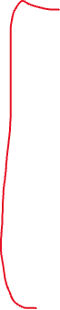

STEP 3: Table Extraction Algorithm
select distinct
cpa.id,
cpa.user_id,
regexp_split_to_table(cpa.roles, ',') as rol,
cpa.modified_by,
case
when cp.user_id is null then concat(gpp.first_name,' ',gpp.last_name)
else concat(cp.first_name,' ',cp.last_name)
end as modified,
case
when cp.user_id is null and gpp.user_id is not null then 'gp person'
when gpp.user_id is null and cp.user_id is not null then 'client person'
when gpp.user_id is not null and cp.user_id is not null then 'both'
else 'none'
end as modified_person,
case when cp.user_id is null and gpp.user_id is not null then gpp.is_enabled
when gpp.user_id is null and cp.user_id is not null then cp.is_enabled
when gpp.user_id is not null and cp.user_id is not null then gpp.is_enabled
end as modifier_is_enabled,
cpa.date_modified,
row_number()over (partition by cpa.id,regexp_split_to_table(cpa.roles, ',') order by cpa.date_modified) as row
from goglobal_gp_goglobal.client_person_aud cpa
left join (
select * from goglobal_gp_goglobal.v_gp_gg_client_person_current
) cp on cpa.modified_by=cp.user_id
left join goglobal_gp_goglobal.v_gp_gg_gp_person_current gpp on cpa.modified_by=gpp.user_id
def _get_customquery_tables(q):
q = q.lower().replace('\n',' ')
l = q.split('from ‘)
print(l)
>>
[
'select distinct cpa.id, cpa.user_id, … ‘,
'goglobal_gp_goglobal.client_person_aud cpa lef t… ‘,
'goglobal_gp_goglobal.v_gp_gg_client_person_current ) cp on’
]

Slide 13
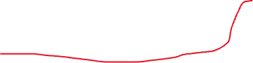

STEP 3: Table Extraction Algorithm
select distinct
cpa.id,
cpa.user_id,
regexp_split_to_table(cpa.roles, ',') as rol,
cpa.modified_by,
case
when cp.user_id is null then concat(gpp.first_name,' ',gpp.last_name)
else concat(cp.first_name,' ',cp.last_name)
end as modified,
case
when cp.user_id is null and gpp.user_id is not null then 'gp person'
when gpp.user_id is null and cp.user_id is not null then 'client person'
when gpp.user_id is not null and cp.user_id is not null then 'both'
else 'none'
end as modified_person,
case when cp.user_id is null and gpp.user_id is not null then gpp.is_enabled
when gpp.user_id is null and cp.user_id is not null then cp.is_enabled
when gpp.user_id is not null and cp.user_id is not null then gpp.is_enabled
end as modifier_is_enabled,
cpa.date_modified,
row_number()over (partition by cpa.id,regexp_split_to_table(cpa.roles, ',') order by cpa.date_modified) as row
from goglobal_gp_goglobal.client_person_aud cpa
left join (
select * from goglobal_gp_goglobal.v_gp_gg_client_person_current
) cp on cpa.modified_by=cp.user_id
left join goglobal_gp_goglobal.v_gp_gg_gp_person_current gpp on cpa.modified_by=gpp.user_id
def _get_customquery_tables(q):
q = q.lower().replace('\n',' ')
l = q.split('from ‘)
print(l)
>>
[
'select distinct cpa.id, cpa.user_id, … ‘,
'goglobal_gp_goglobal.client_person_aud cpa lef t… ‘,
'goglobal_gp_goglobal.v_gp_gg_client_person_current ) cp on’
]

Slide 14


STEP 3: Table Extraction Algorithm
select distinct
cpa.id,
cpa.user_id,
regexp_split_to_table(cpa.roles, ',') as rol,
cpa.modified_by,
case
when cp.user_id is null then concat(gpp.first_name,' ',gpp.last_name)
else concat(cp.first_name,' ',cp.last_name)
end as modified,
case
when cp.user_id is null and gpp.user_id is not null then 'gp person'
when gpp.user_id is null and cp.user_id is not null then 'client person'
when gpp.user_id is not null and cp.user_id is not null then 'both'
else 'none'
end as modified_person,
case when cp.user_id is null and gpp.user_id is not null then gpp.is_enabled
when gpp.user_id is null and cp.user_id is not null then cp.is_enabled
when gpp.user_id is not null and cp.user_id is not null then gpp.is_enabled
end as modifier_is_enabled,
cpa.date_modified,
row_number()over (partition by cpa.id,regexp_split_to_table(cpa.roles, ',') order by cpa.date_modified) as row
from goglobal_gp_goglobal.client_person_aud cpa
left join (
select * from goglobal_gp_goglobal.v_gp_gg_client_person_current
) cp on cpa.modified_by=cp.user_id
left join goglobal_gp_goglobal.v_gp_gg_gp_person_current gpp on cpa.modified_by=gpp.user_id
def _get_customquery_tables(q):
q = q.lower().replace('\n',' ')
l = q.split('from ‘)
print(l)
>>
[
'select distinct cpa.id, cpa.user_id, … ‘,
'goglobal_gp_goglobal.client_person_aud cpa lef t… ‘,
'goglobal_gp_goglobal.v_gp_gg_client_person_current ) cp on’
]

Slide 15

STEP 3: Table Extraction Algorithm
select distinct
cpa.id,
cpa.user_id,
regexp_split_to_table(cpa.roles, ',') as rol,
cpa.modified_by,
case
when cp.user_id is null then concat(gpp.first_name,' ',gpp.last_name)
else concat(cp.first_name,' ',cp.last_name)
end as modified,
case
when cp.user_id is null and gpp.user_id is not null then 'gp person'
when gpp.user_id is null and cp.user_id is not null then 'client person'
when gpp.user_id is not null and cp.user_id is not null then 'both'
else 'none'
end as modified_person,
case when cp.user_id is null and gpp.user_id is not null then gpp.is_enabled
when gpp.user_id is null and cp.user_id is not null then cp.is_enabled
when gpp.user_id is not null and cp.user_id is not null then gpp.is_enabled
end as modifier_is_enabled,
cpa.date_modified,
row_number()over (partition by cpa.id,regexp_split_to_table(cpa.roles, ',') order by cpa.date_modified) as row
from goglobal_gp_goglobal.client_person_aud cpa
left join (
select * from goglobal_gp_goglobal.v_gp_gg_client_person_current
) cp on cpa.modified_by=cp.user_id
left join goglobal_gp_goglobal.v_gp_gg_gp_person_current gpp on cpa.modified_by=gpp.user_id
def _get_customquery_tables(q):
q = q.lower().replace('\n',' ')
l = q.split('from ‘)
l = l[1:]
l = [s.split(' ')[0] for s in l]
print(l)
>>
[
'goglobal_gp_goglobal.client_person_aud',
'goglobal_gp_goglobal.v_gp_gg_client_person_current’
]

Slide 16
STEP 3: Table Extraction Algorithm
select distinct
cpa.id,
cpa.user_id,
regexp_split_to_table(cpa.roles, ',') as rol,
cpa.modified_by,
case
when cp.user_id is null then concat(gpp.first_name,' ',gpp.last_name)
else concat(cp.first_name,' ',cp.last_name)
end as modified,
case
when cp.user_id is null and gpp.user_id is not null then 'gp person'
when gpp.user_id is null and cp.user_id is not null then 'client person'
when gpp.user_id is not null and cp.user_id is not null then 'both'
else 'none'
end as modified_person,
case when cp.user_id is null and gpp.user_id is not null then gpp.is_enabled
when gpp.user_id is null and cp.user_id is not null then cp.is_enabled
when gpp.user_id is not null and cp.user_id is not null then gpp.is_enabled
end as modifier_is_enabled,
cpa.date_modified,
row_number()over (partition by cpa.id,regexp_split_to_table(cpa.roles, ',') order by cpa.date_modified) as row
from goglobal_gp_goglobal.client_person_aud cpa
left join (
select * from goglobal_gp_goglobal.v_gp_gg_client_person_current
) cp on cpa.modified_by=cp.user_id
left join goglobal_gp_goglobal.v_gp_gg_gp_person_current gpp on cpa.modified_by=gpp.user_id
def _get_customquery_tables(q):
q = q.lower().replace('\n',' ')
ls = []
for con in ['from ','join ']:
l = q.split(con)[1:]
l = [s.split(' ')[0] for s in l]
ls.append(l)
>>
[
[
'goglobal_gp_goglobal.client_person_aud',
'goglobal_gp_goglobal.v_gp_gg_client_person_current'
],
[
'goglobal_gp_goglobal.v_gp_gg_gp_person_current'
]
]

Slide 17
STEP 3: Table Extraction Algorithm
select distinct
cpa.id,
cpa.user_id,
regexp_split_to_table(cpa.roles, ',') as rol,
cpa.modified_by,
case
when cp.user_id is null then concat(gpp.first_name,' ',gpp.last_name)
else concat(cp.first_name,' ',cp.last_name)
end as modified,
case
when cp.user_id is null and gpp.user_id is not null then 'gp person'
when gpp.user_id is null and cp.user_id is not null then 'client person'
when gpp.user_id is not null and cp.user_id is not null then 'both'
else 'none'
end as modified_person,
case when cp.user_id is null and gpp.user_id is not null then gpp.is_enabled
when gpp.user_id is null and cp.user_id is not null then cp.is_enabled
when gpp.user_id is not null and cp.user_id is not null then gpp.is_enabled
end as modifier_is_enabled,
cpa.date_modified,
row_number()over (partition by cpa.id,regexp_split_to_table(cpa.roles, ',') order by cpa.date_modified) as row
from goglobal_gp_goglobal.client_person_aud cpa
left join (
select * from goglobal_gp_goglobal.v_gp_gg_client_person_current
) cp on cpa.modified_by=cp.user_id
left join goglobal_gp_goglobal.v_gp_gg_gp_person_current gpp on cpa.modified_by=gpp.user_id
def _get_customquery_tables(q):
q = q.lower().replace('\n',' ')
ls = []
for con in ['from ','join ']:
l = q.split(con)[1:]
l = [s.split(' ')[0] for s in l]
ls.append(l)
ls = [d for l in ls for d in l]
>>
[
'goglobal_gp_goglobal.client_person_aud',
'goglobal_gp_goglobal.v_gp_gg_client_person_current', 'goglobal_gp_goglobal.v_gp_gg_gp_person_current'
]

Slide 18

Appendix | Python & Pandas
import pandas as pd
some_list = [0, 3, 6, 9, 12, 15, 18, 21, 24, 27]
some_list = []
for i in range(0,10):
some_list.append(i*3)
some_list = [i*3 for i in range(0,10)]
Ways to iterate
data = [
{'id':1, 'value':0},
{'id':2, 'value':3},
{'id':3, 'value':6},
{'id':4, 'value':9},
]
df = pd.DataFrame(data)
df['value_modified'] = df.value*10
=
Data Structures
Reading files
some_text_file = open('some_file.anyextension','r').read()
denominator = 0
try:
some_division = 2/denominator
except:
print('divided by 0! divided by 1 instead’)
some_division = 2/1
Catching/Managing errors

